Slide 1
Informatics Tools for Biodiversity Data Conversion
Kittinan Ponkaew
VisLab, Osaka
8/14/2013

Slide 2
Week 8 Progress
Successfully set up the default web portal for Specify. Will need to extend it to allowed custom website to access it.
Consolidated important software to make everything work well together. Apache (MAMP) for testing, Solr for search engine, and Specify.
Still problems with some missing data that will need to be filled with temporary value so that everything else would work.

Slide 3
Plans for Week 9
Populate server for demonstration, and finish up a working model.
Process any late data that was requested earlier.
Finish up important documentations.
Get ready for the project presentation and report.

Slide 4
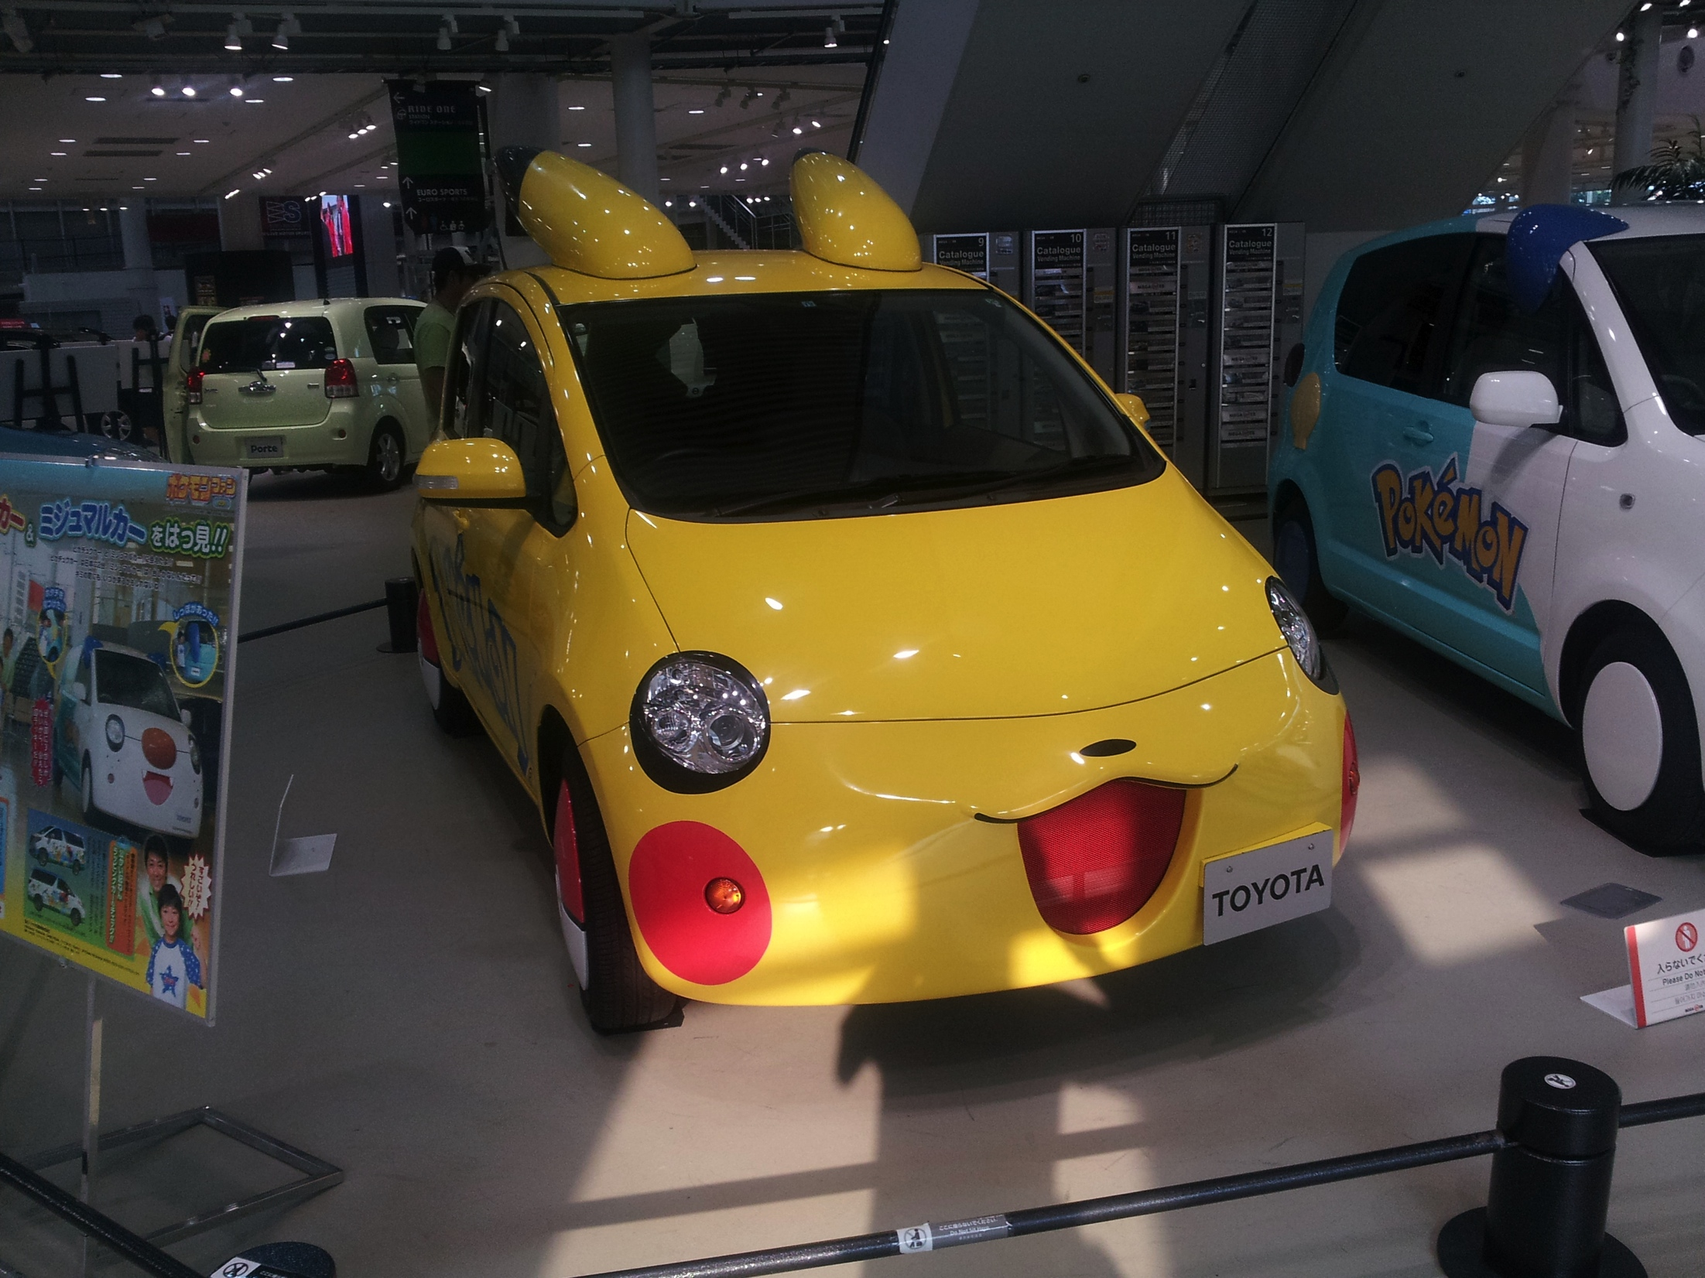
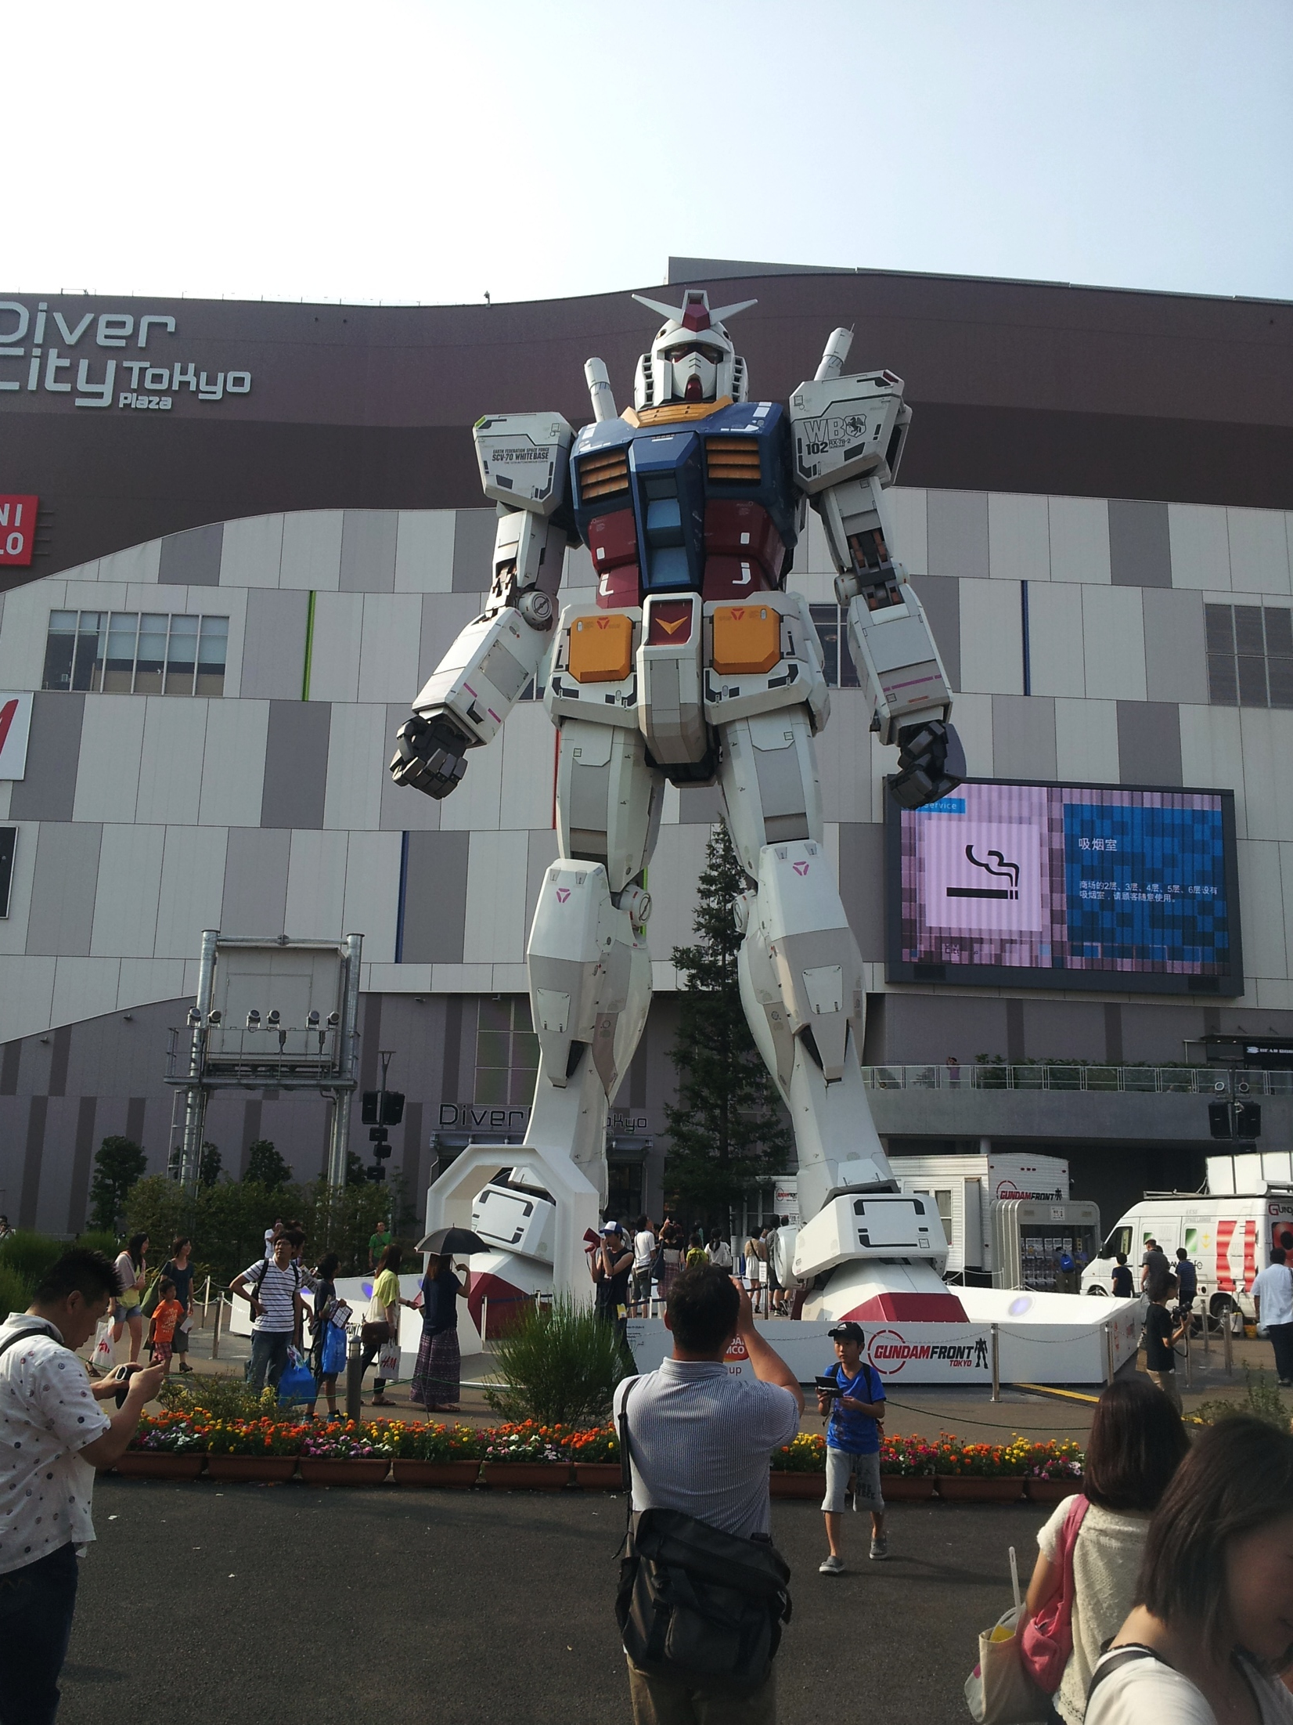
Cultural Exploration
Odaiba was awesome!

Slide 5
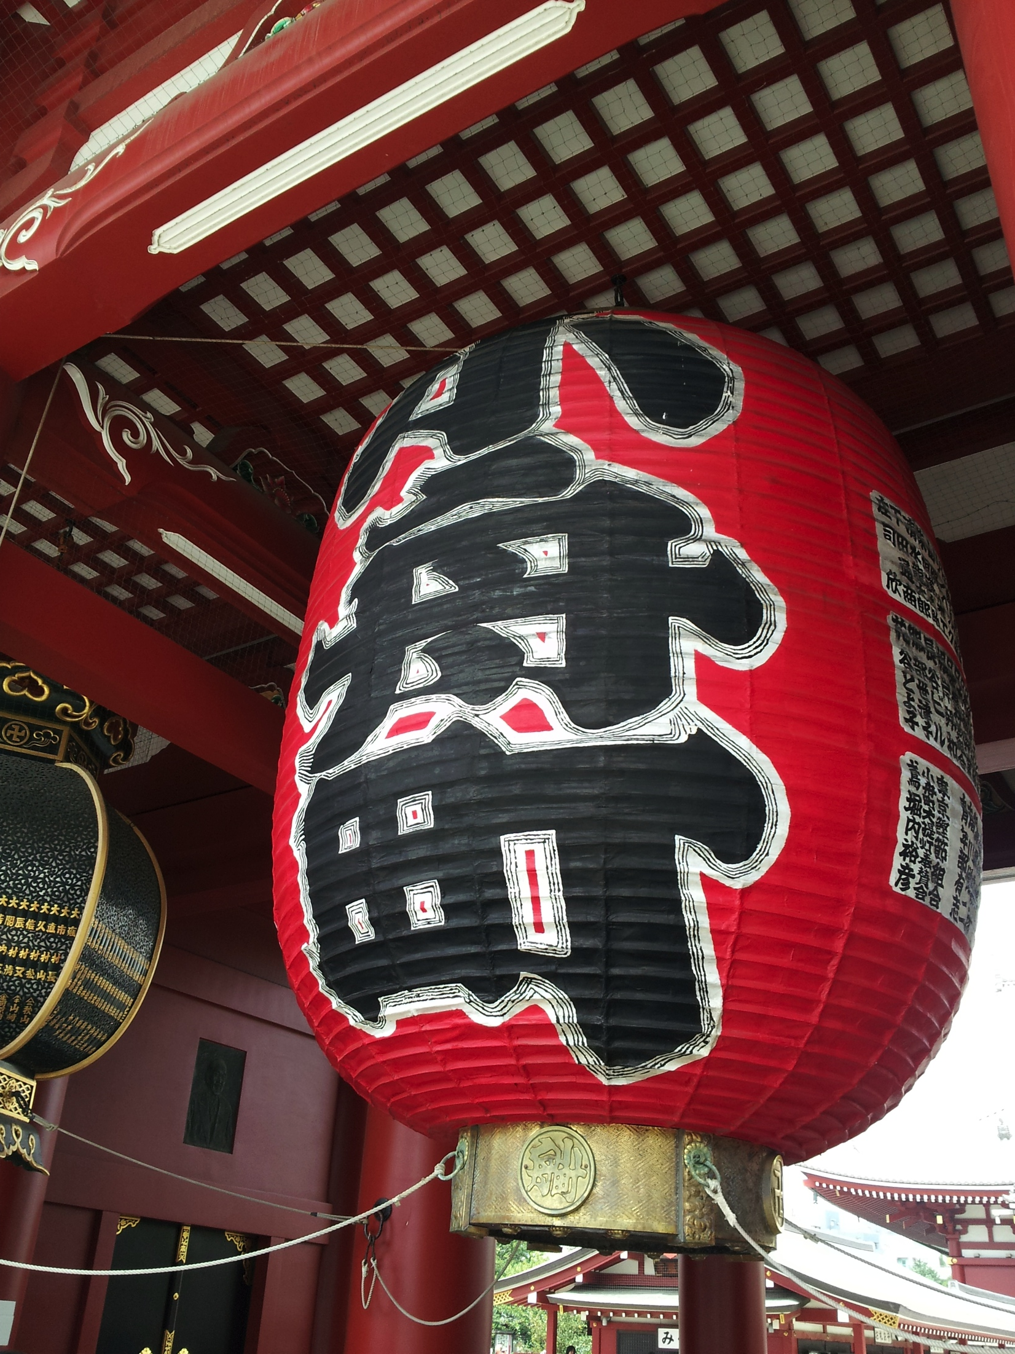
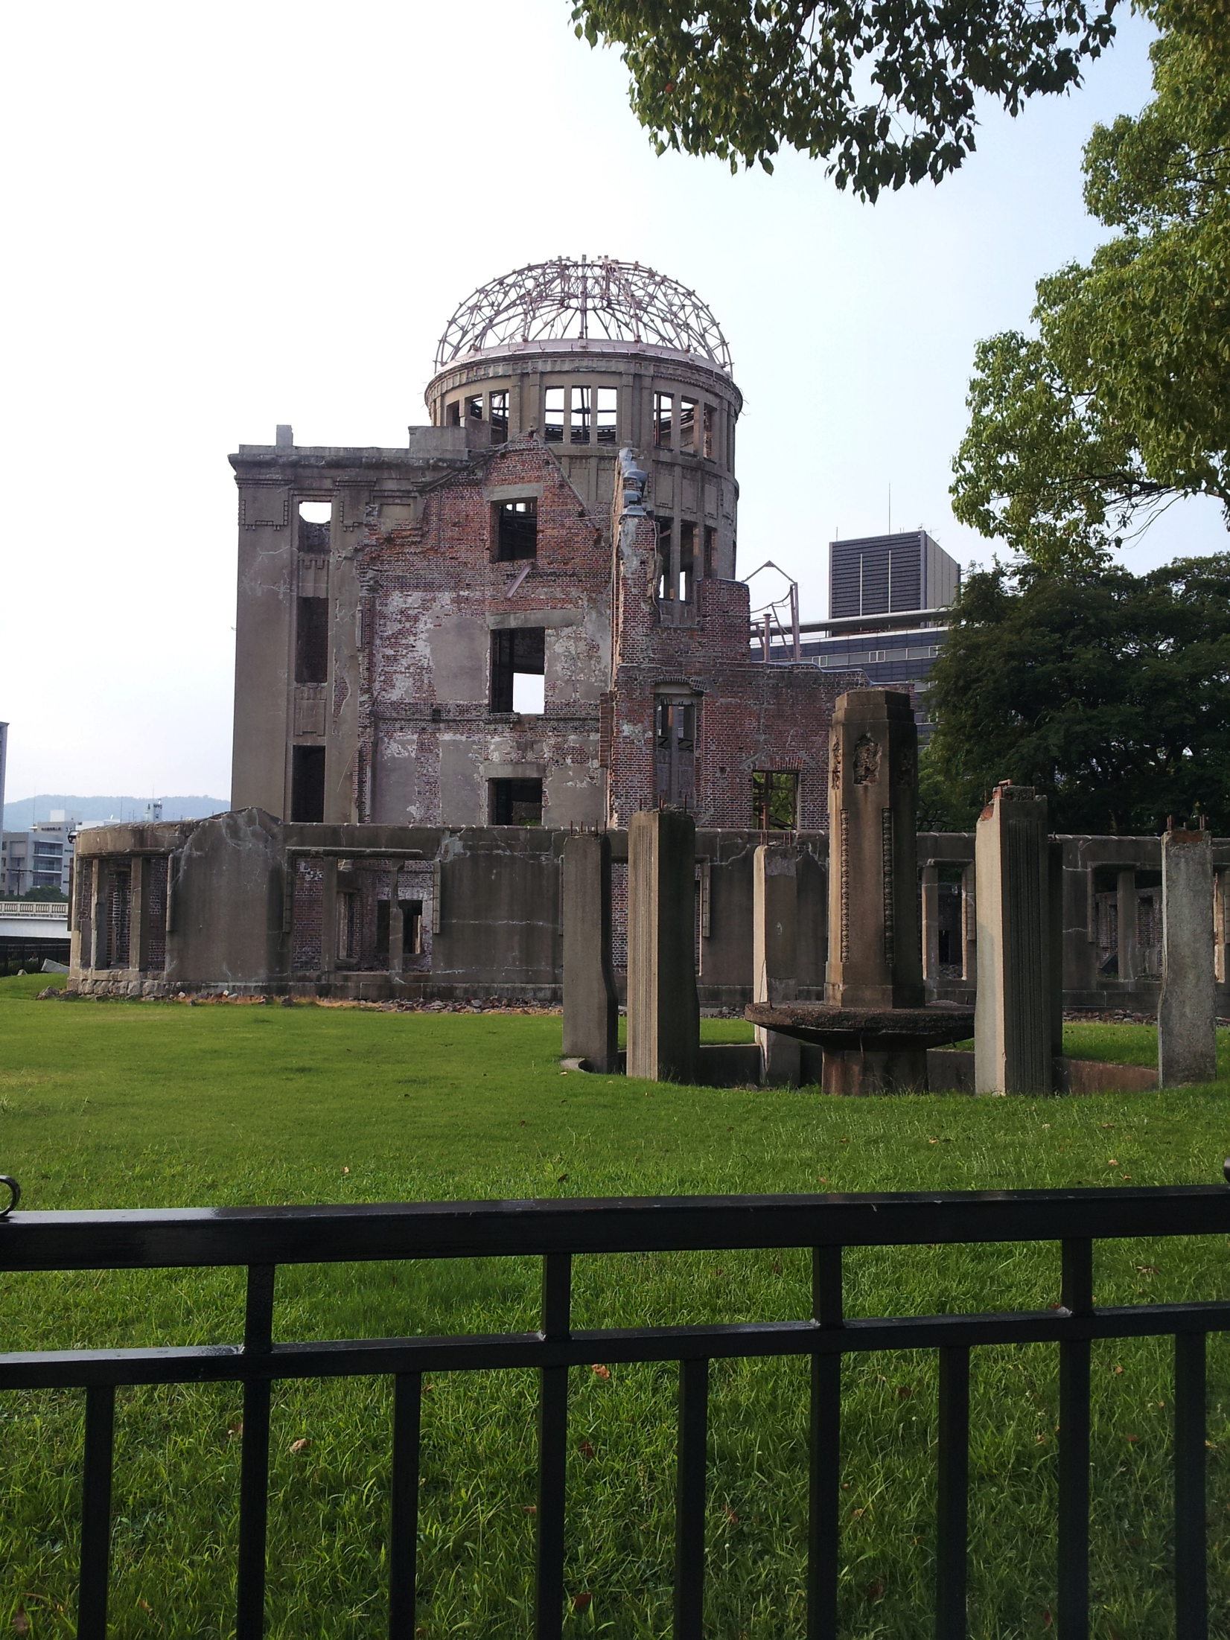
Cultural Exploration 2
Temple and 原爆ドーム

Slide 6
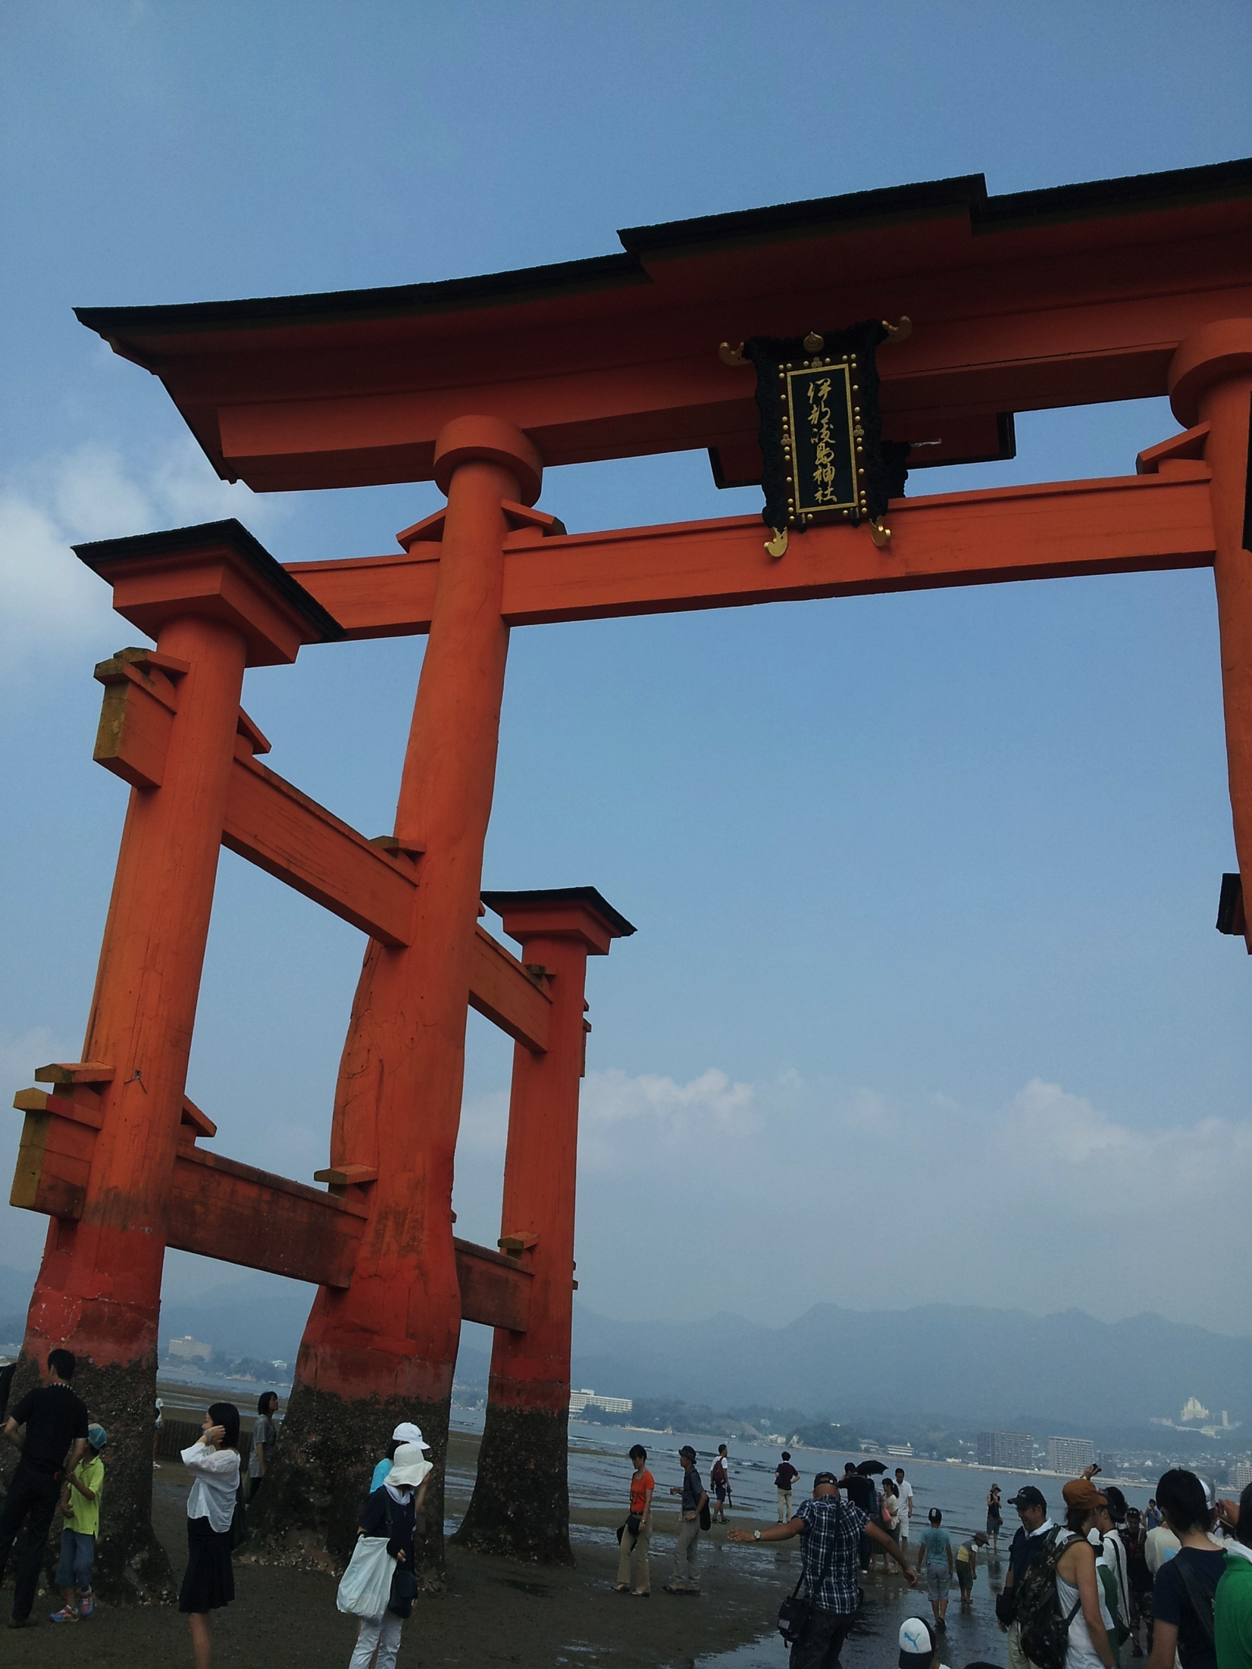
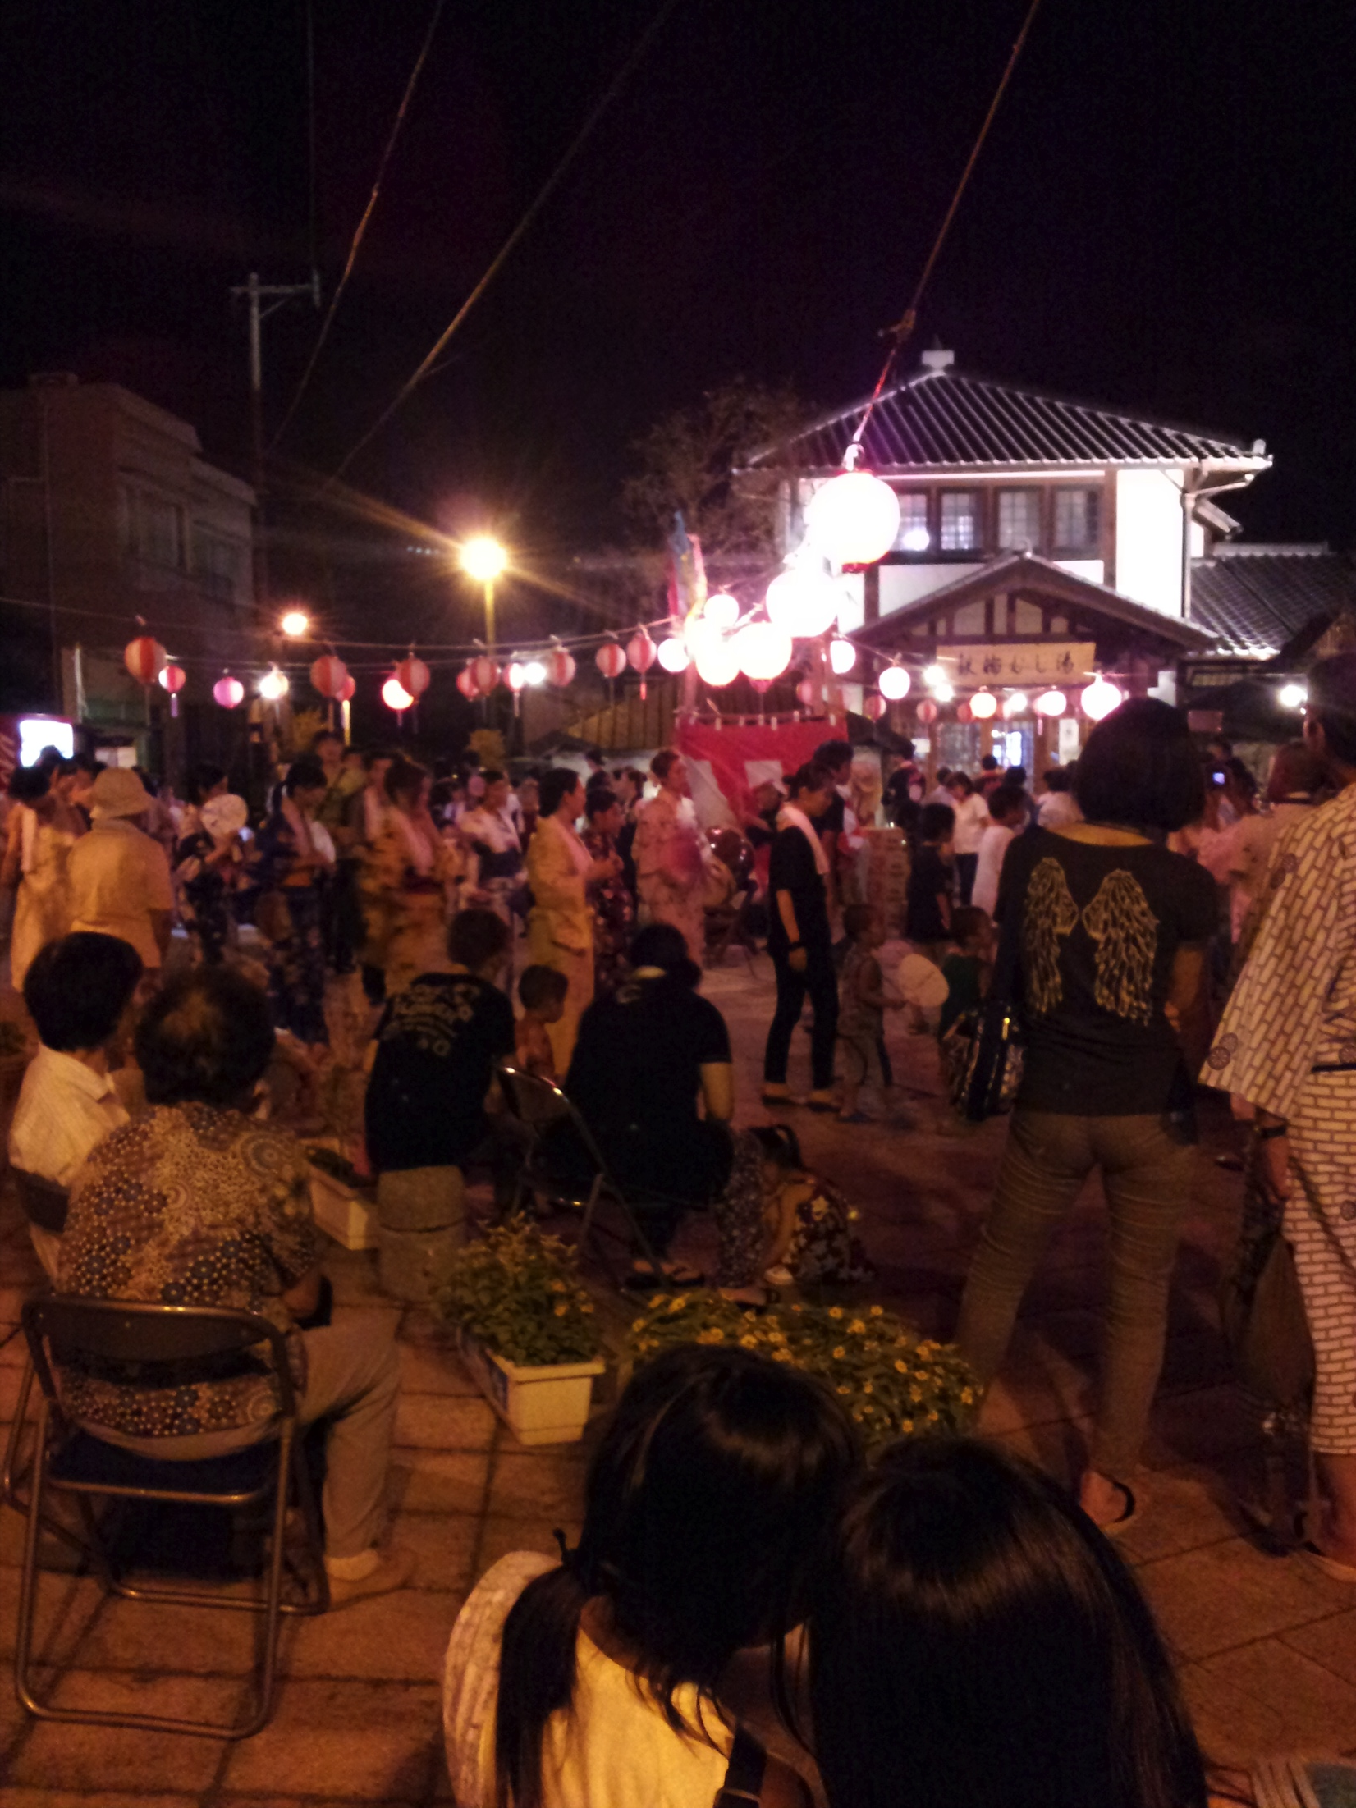
Cultural Exploration 3
Miyajima and festival in Beppu. Both great places to visit.

Slide 7
Acknowledgement
Gabriele Wienhausen
Dr. Jason Haga
Dr. Shinji Shimojo and NICT
PRIME
Balboa Park Online Collaboration
PRIME alumna Haley Hunter-Zinck
NSF
KU Specify Project and Staff

